Slide 1
SAP Presentation
Accounts Payable

Slide 2
Vendor Invoice from FI side
SAP Easy Access → Accounting → Financial Accounting → Accounts Payable → Document Entry → Invoice.
Transaction Code FB60
On the Enter Vendor Invoice: Header Data screen, enter the following data
Vendor Enter Vendor Code
Invoice Date Document Date
Posting Date Posting Date
Reference Document Reference
Amount Amount of the invoice
Business Place To be entered if any TDS to be deducted for that vendor
Text Narration
G/L Account To be entered
Amount To be entered
Text Narration
Business Area To be entered only when Cost Center is not there. If cost center is entered Bus. Area is defaulted
Cost Center To be entered if that particular head of GL A/c has to be collected to cost center

Slide 3
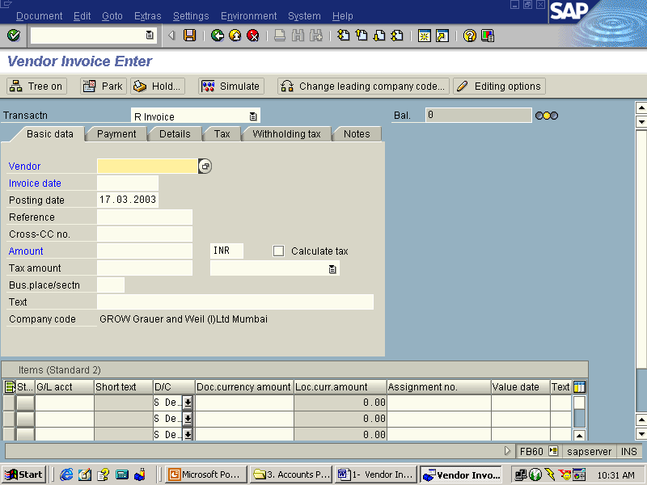

Slide 4
Press Simulate button to see the entry passed
Press Save Button finally to post the transaction
Take note of the Document number for future reference
To display the document posted Press Document → Display or use Transaction FB03 and enter the said document number and press enter.

Slide 5
Vendor Credit Memo, Debit Memo from FI side and JV
Credit Memo/ Debit Memo will usually flow from MM Module only for price differences/ goods returns etc., In case a credit /debit memo has to be posted from FI, following documentation may be followed.
Vendor Credit Memo (In fact a Debit Memo)
In the SAP system there is no concept of Debit Memo available for either Vendor or Customer. Vendor Credit Memo works in SAP as a debit memo as the same will debit the vendor a/c. So, to debit a Vendor, use Credit Memo.
SAP Easy Access → Accounting → Financial Accounting → Accounts Payable → Document Entry → Credit Memo.
Transaction Code FB65
Document Type KG (Vendor Credit Memo)

Slide 6
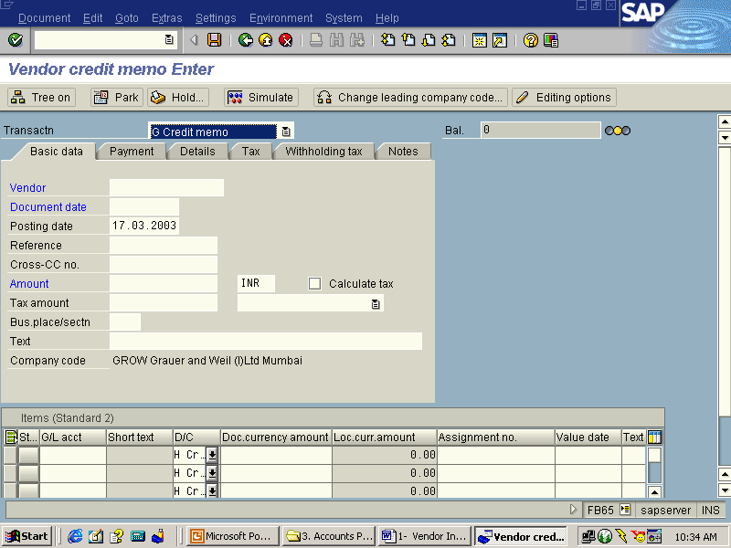

Slide 7
Vendor Credit Memo
Incase we want to post to the credit of a Vendor A/c from FI side, following route can be followed.
SAP Easy Access → Accounting → Financial Accounting → General Ledger → Document Entry → Others → General Postings.
Transaction Code F-02
Alternatively Transaction Code: FB01 (Post Document ) may also be used.
Main Points
Pstkey 36 (Payment Difference- Vendor Credit)
Doc.Type KA (Vendor Document)

Slide 8
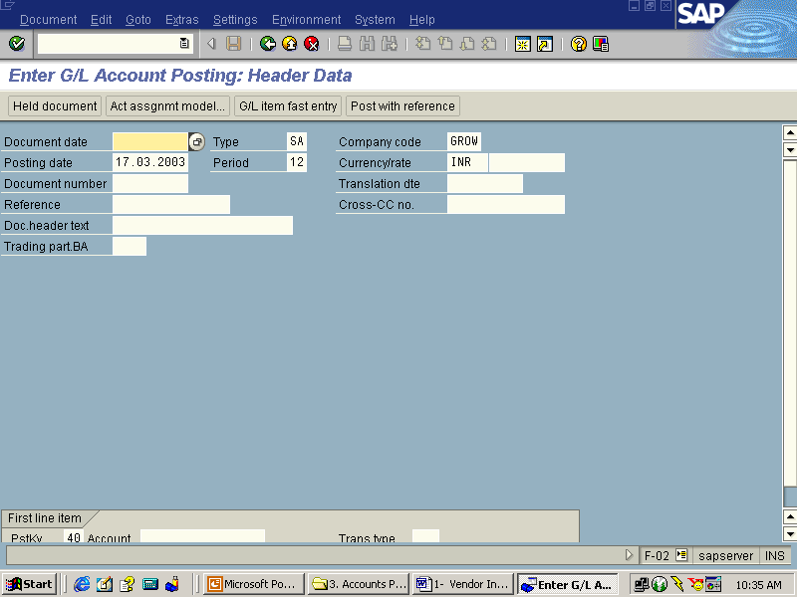

Slide 9
Vendor Journal Posting
SAP Easy Access → Accounting → Financial Accounting → General Ledger → Document Entry → Others → General Postings.
Transaction Code F-02
Main Points
Doc.Type KA (Vendor Document)
Alternatively Transaction Code: FB01 (Post Document ) may also be used.
Posting key
If Vendor is to be debited
(Other receivables Vendor Debit)
50 (G/L Account Credit)
If Vendor is to be credited
34 (Other Payables Vendor credit)
40 (G/L Account Credit)

Slide 10
Post Vendor Down Payments
S.NO. : 01- FI-AP- 01
TRANSACTION CODE : F – 48
ACCESS PATH :SAP Easy Access - Accounting- Financial Accounting- Accounts Payable - Document Entry - Down payment - Down Payment
We get “ Post Vendor Down Payment” Header data” screen ;
Required Fields:
Document date : To be entered
Account : To be entered (Vendor A/c Number)
Spl. G/L Ind. : To be set at “A” (down Payment on current asset)
Post date : Default
Amount : Total amount inclusive Bank Charges to be entered
Bank Charges : To be entered
Rest all other fields viz, Doc Type, Period, Company code,Currency/Rate are default after they are entered for the first time.
We get the Screen “Post Vendor Down Payment - Header Data“ incorporating the above mentioned required fields as under;
Press ENTER Button

Slide 11
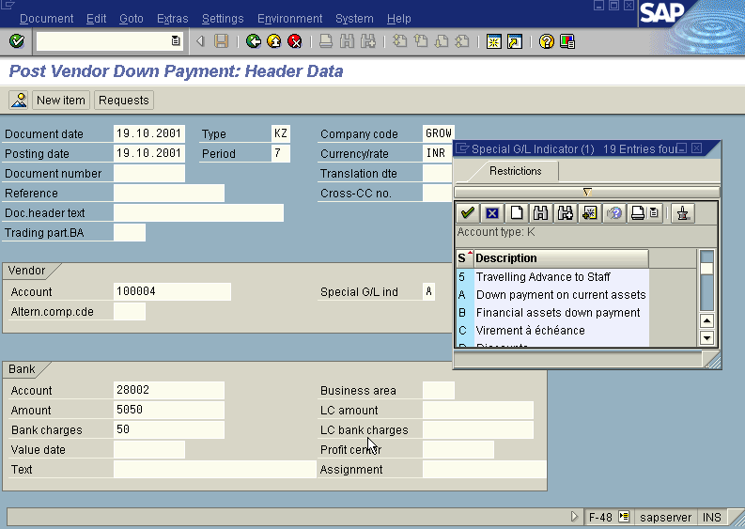

Slide 12
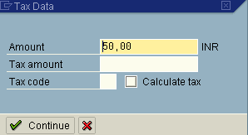
A screen relating to the “Tax Data” will appear as under
Press ENTER Button

Slide 13
The system will display the below message
Bank charges are subject to tax please add more data
Press continue button
The system will display the below warning message.
GL account 85008 is relevant to tax please check code
Press continue button
Now we get the screen “ Post Vendor Down payment – Add Vendor Item” .
In this screen fill three fields –
Amount (exclusive of bank charges )
Due date
Purchase Document
The screen is pasted hereunder along with the inputs in these three fields.

Slide 14
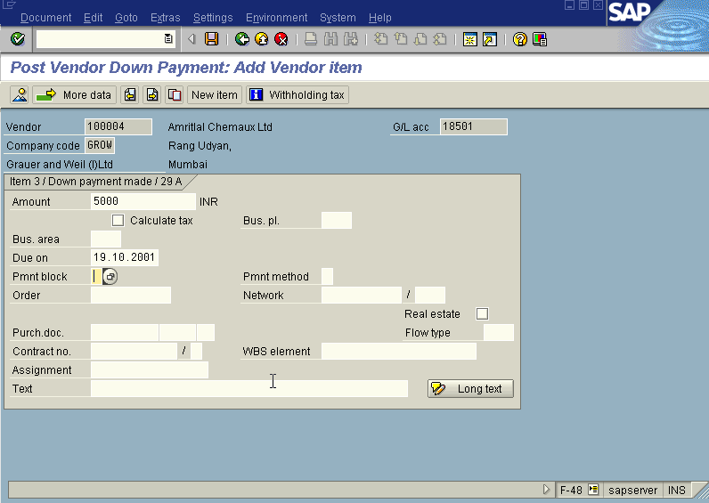
Press ENTER Button

Slide 15
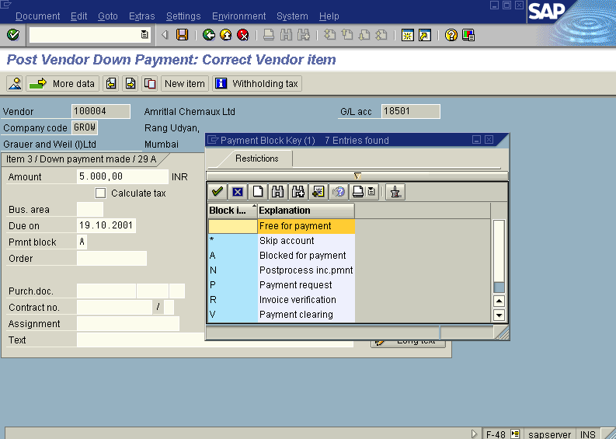
We will be presented with “ Post Vendor Down payment – Correct Vendor Item”
Screen.
The payment block field in the above screen will show “A” (Blocked for payment) . The screen will appear as under.

Slide 16
Press Enter button
Press Save button
The system will display a message as under
Document 1500090 was posted in company code GROW
Take a note of the document number ; 1500090.
This is the stage where “Post vendor down payment” stage is complete
The document can be seen from Document Display from the top left hand side of the main screen “post Vendor down payment - Header Data“ OR from Transaction code FB- 03 .The Document overview screen will be displayed as under showing the entries.

Slide 17
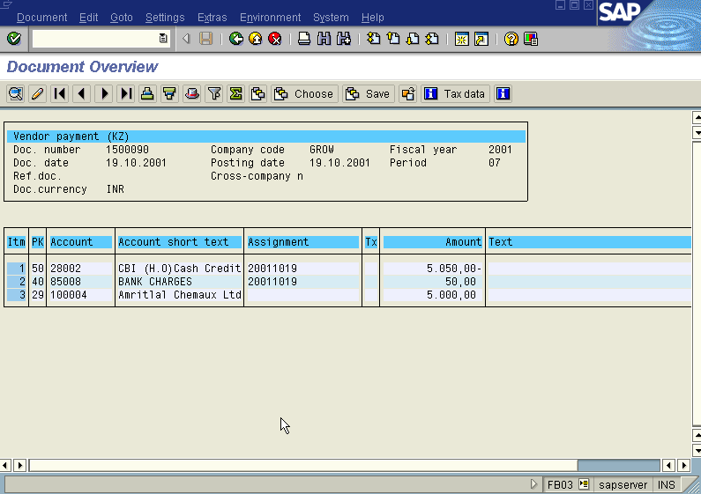

Slide 18
Clear Vendor Down Payment
S.NO : 01-FI-AP-02
TRANSACTION CODE : F – 54
ACCESSB PATH : SAP Easy Access- Accounting Financial Accounting - Accounts Payable – Document Entry - Down payment - Clearing
We get “ Clear Vendor Down Payment – Header Data” Screen
Required Fields:
Document date : To be entered
Account : To be entered (Vendor A/c Number)
Posting date : Default
Fiscal Year : Default
Rest all other fields viz, Doc Type, Period, Companycode,Currency/Rate are default after they are entered for the first time
We get the Screen “Clear Vendor Down Payment - Header Data“ incorporating the above mentioned required fields as under;

Slide 19
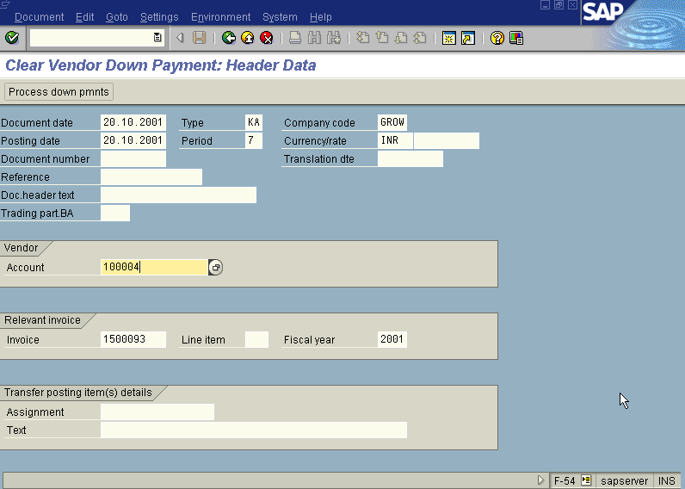
From the above “Clear Vendor Down Payment - Header Data“ screen before pressing enter button one point that has to be kept in mind is deletion of invoice number which is appearing as default under section Relevant invoice in the “Clear Vendor Down Payment - Header Data” screen.
Press Enter button

Slide 20
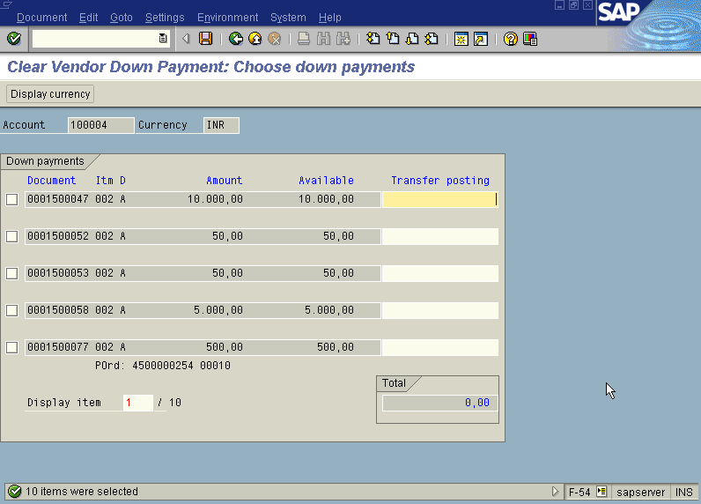
We will be presented with “ Clear Vendor Down Payment – Choose Down Payments” screen as below

Slide 21
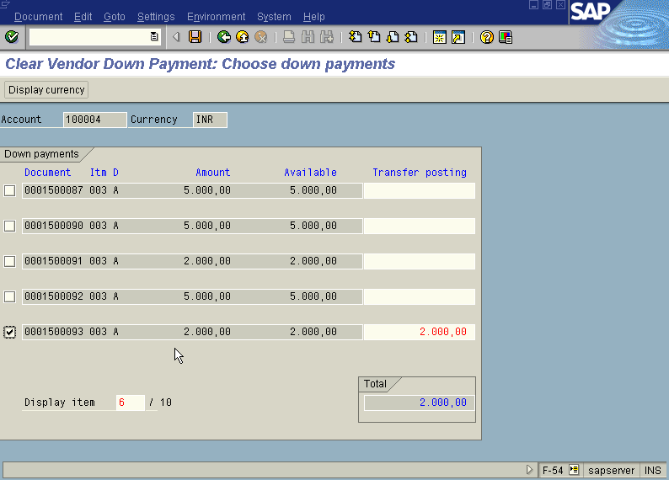
Press Page Down Button from Key board till the point you find the Down payment/s which are to be cleared from the above “ Clear Vendor Down Payment – Choose Down Payments” screen. Once you have found the down payment you wanted to clear just put a tick mark on the check box appearing to the left side of down payments list as in the screen shown below;

Slide 22
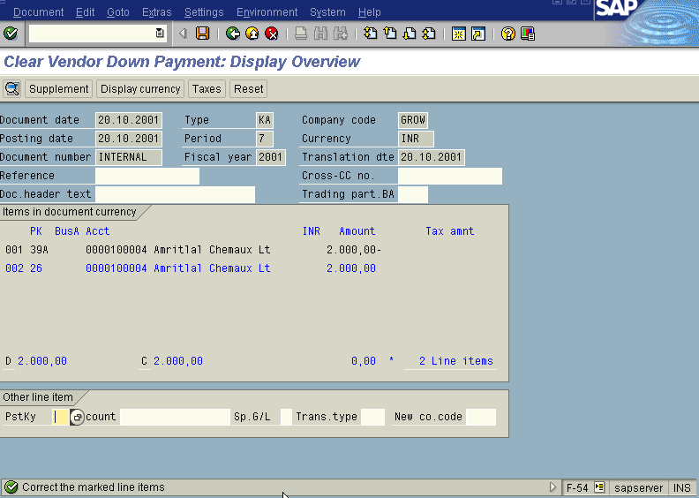
Press Save button
We will get “ Clear Vendor Down Payment – Display Overview” screen as below with a message “ correct the marked line items at the bottom with a green tick as below;

Slide 23
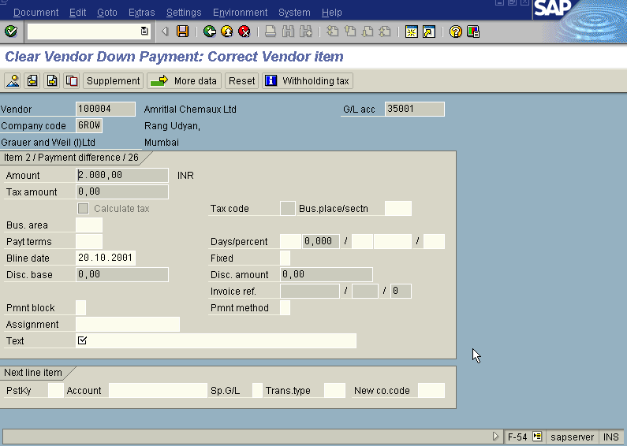
In the above “ Clear Vendor Down Payment – Display Overview” screen , just double click with the mouse on the blue colour highlited line item. We will get the
“ Clear Vendor Down Payment – correct Vendor Item” screen as displayed below with symbol under Text field.

Slide 24
Fill the Text field with appropriate text in the above “ Clear Vendor Down Payment – correct Vendor Item” screen.
Press Save button
The system will display a message as under
Document 1700024 was posted in company code GROW
Take a note of the document number ; 1700024
This is the stage where “clearing vendor down payment” stage is complete
The document can be seen from Document Display from the top left hand side of the main screen “post Vendor down payment - Header Data“ OR from Transaction code FB- 03 .The Document overview screen will be displayed as under showing the entries.

Slide 25
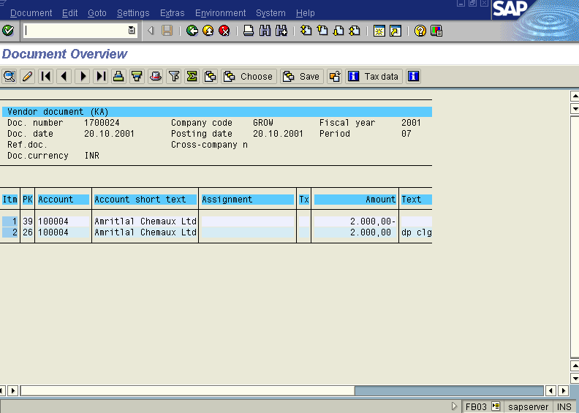

Slide 26
Post Outgoing Payment (Down Payment)
S.NO. : 01- FI-AP- 03
TRANSACTION CODE : F – 53
ACCESS PATH : SAP Easy Access - Accounting - Financial Accounting - Accounts Payable – Document Entry - Out going payment Post
We get “ Post Out Going Payment” Header data” screen ;
Required Fields:
Document date : To be entered
Account : To be entered (Vendor A/c Number)
Account Type : Default
Standard Ois : Default Ticked
Account : To be entered (Bank A/c Number
Posting date : Default
Amount : Total amount inclusive Bank Charges to be entered
Bank Charges : To be entered
Rest all other fields viz, Doc Type, Period, Company code, Currency /Rate are default after they are entered for the first time.
We get the Screen “Post Out Going Payment - Header Data“ incorporating the above mentioned required fields as under;

Slide 27
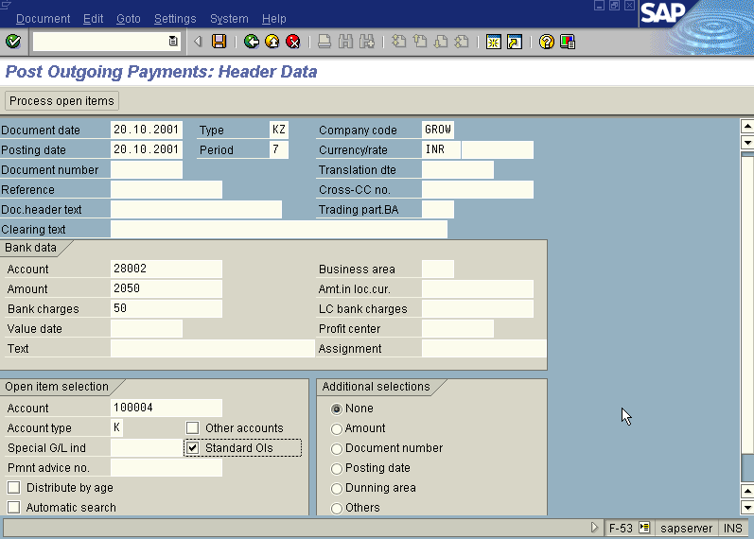
The point to be noted in the above “Post Out Going Payment - Header Data” screen is we have to leave the Spl. G/L Indicator field blank because we are clearing the Spl. G/L item down payment against the invoice.
Press process open item button

Slide 29
A screen relating to the “Tax Data” will appear as under

Slide 30
Press continue button
The system will display the below message
Bank charges are subject to Tax please add more data
Press continue button
The system will display the below warning message.
GL account 85008 relevant to tax, check code
Press continue button
Now we get “ Post Out Going Payment – Process Open Items” screen as below

Slide 31
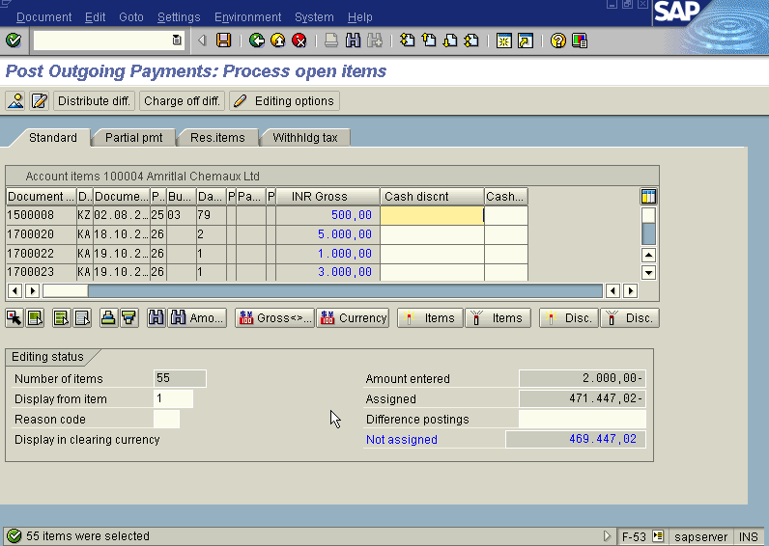

Slide 32
In the above “ Post Out Going Payment – Process Open Items” screen
Press icon (Select all) so that all items will be highlighted in blue.
Press icon (Deactivate items) so that all items will be highlighted in blue turns to normal in black
Now use the Scroll bar on the above “ Post Out Going Payment – Process Open Items” screen till you find your Invoice on the above Screen. Then once we have found the Invoice we wanted to post, Just just double click with the mouse on the Amount field eg. 2000 in this case so the amount highlighted will turn to blue colour and the Not assigned field will turn to Zero . Here we should keep in mind that this Not assigned field has to be brought to zero to make the posting.
Press Save button
The system will display a message as under
Document 1500094 was posted to company code GROW
Take a note of the document number ; 1500094
This is the stage where “Post Out Going payment” stage is complete

Slide 33
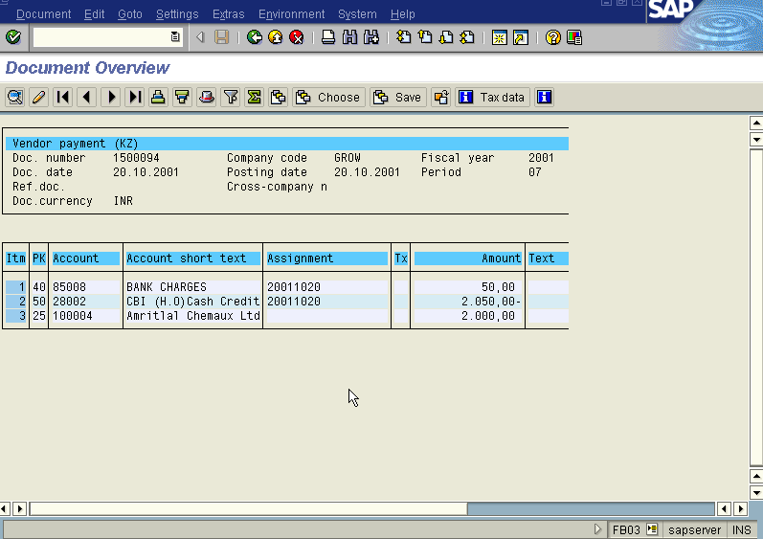
The document can be seen from Document Display from the top left hand side of the main screen “post out going payment - Header Data“ OR from Transaction code FB- 03 .The Document overview screen will be displayed as under showing the entries.

Slide 34
Post Bill Of Exchange (Vendor)
S.NO. : 01-FI-AP-04
TRANSACTION CODE : F – 40
ACCESS PATH : SAP Easy Access – Accounting – Financial A/c - Document Entry - Bill of Exchange - Payment
On the screen “ Bill of exchange Payment: Header Data”, enter information in the fields as specified table below:
Required fields:
Document date : To be entered
Document Type : Defaults to “KZ”
Company Code : Default (after entered for First Time)
Posting Date : Default (after entered for First Time)
Period : Default (after entered for First Time)
Currency : Default (after entered for First Time)
Transaction to be
Processed : Defaulted at outgoing payment
Posting Key : Default
Account : To be entered
Spl. G/L Ind. : Default (at “W”
We get the “Bill Of Exchange Payment – Header Data” screen as below

Slide 35
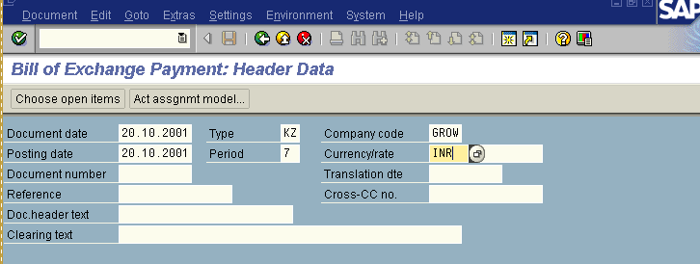
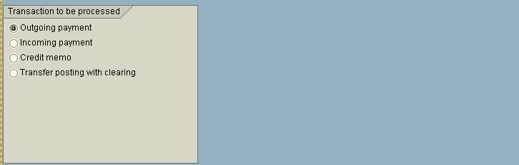

Slide 36
On the above “Bill Of Exchange Payment – Header Data” screen
Press process open item button
We will get “Bill Of Exchange Payment - Add Vendor Item” Screen
In the above “Bill Of Exchange Payment - Add Vendor Item” Screen
Required fields;
Amount : To be entered
Due Date : To be entered
Rest all items viz; Drawer, Drawee details etc. are by default.
After Incorporating the above data in the above “Bill Of Exchange Payment - Add Vendor Item” Screen we get the display as hereunder;

Slide 37
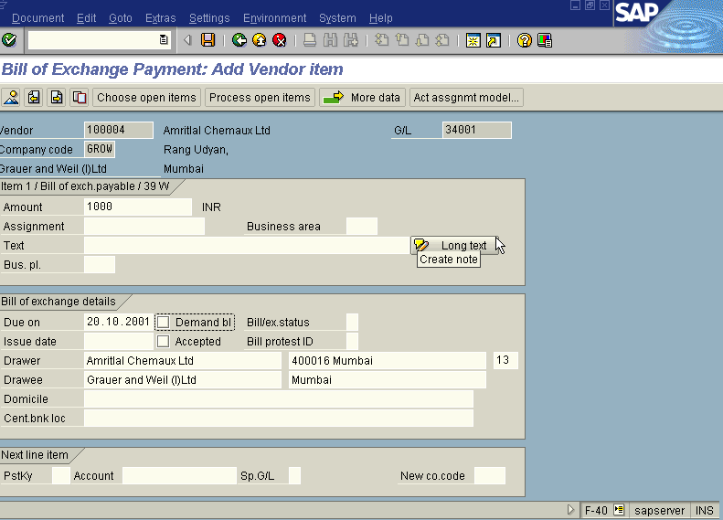
In the above “Bill Of Exchange Payment - Add Vendor Item” Screen
Press process open item button
We get the “Bill Of Exchange Payment - select open items” screen
In the above “Bill Of Exchange Payment - select open items” screen the fields viz; company code, account (Vendor account number), account type appear as default. The screen will be displayed as under

Slide 38
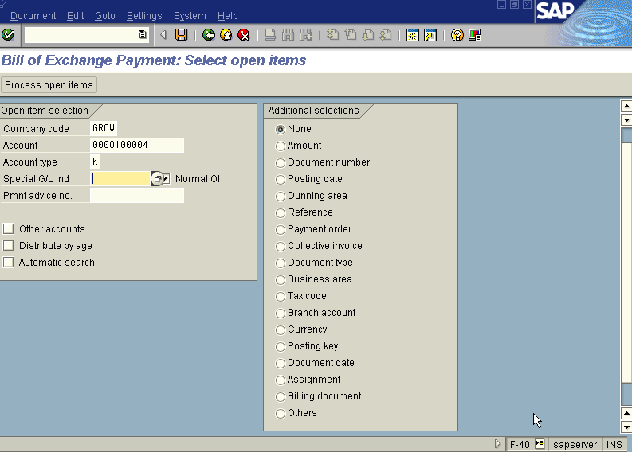
In the above “Bill Of Exchange Payment - select open items” screen, We leave the SPL. G/L Indicator field blank because we are clearing the bill of exchange against the invoice
Press process button
Press save button
We get “Bill of Exchange Payment – Process open items” screen as under

Slide 39
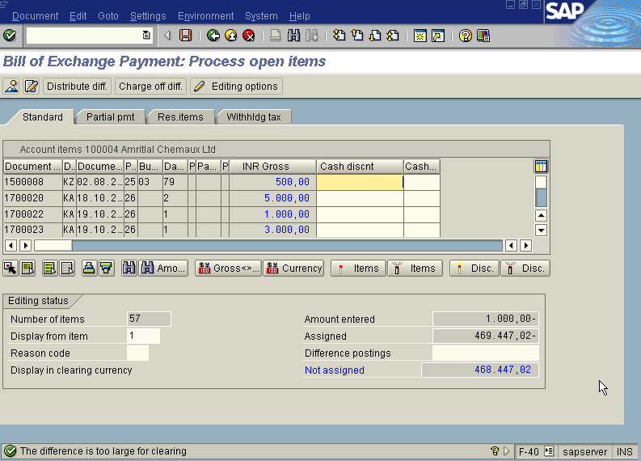
In the above “Bill of Exchange Payment – Process open items” screen
Press icon (Select all) so that all items will be highlighted in blue.
Press icon (Deactivate items) so that all items highlighted in blue turns to normal in black

Slide 40
Now use the Scroll bar on the above “Bill of Exchange Payment – Process Open Items” screen till you find your Invoice on the above Screen. Then once we have found the Invoice we wanted to post, Just just double click with the mouse on the Amount field eg. 1000 in this case so the amount highlighted will turn to blue colour and the Not assigned field will turn to Zero . Here we should keep in mind that this Not assigned field has to be brought to zero to make the posting.
Press Save button
Document 1500097 was posted to company code GROW
Take a note of the document number ; 1500097
This is the stage where “Bill of Exchange Payment” stage is complete

Slide 41
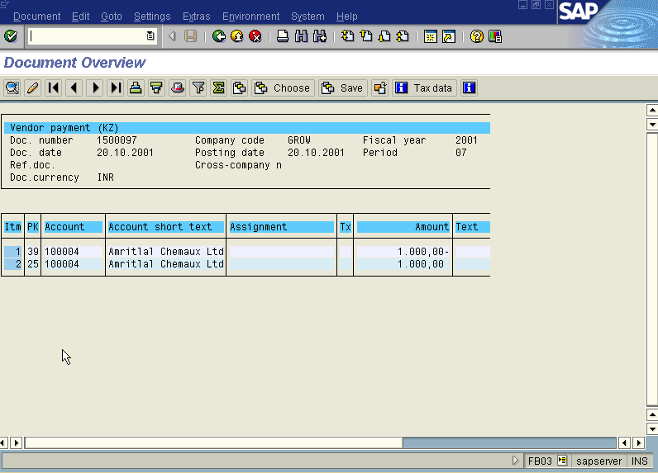
The document can be seen from Document Display from the top left hand side of the main screen “post out going payment - Header Data“ OR from Transaction code FB- 03 .The Document overview screen will be displayed as under showing the entries.

Slide 42
Post Out Going Payment (Bill of Exchange)
S.NO. : 01- FI-AP- 05
TRANSACTION CODE : F – 53
ACCESS PATH : SAP Easy Access - Accounting - Financial Accounting - Accounts Payable - Document Entry - Out going payment -Post
We get “ Post Out Going Payment” Header data” screen ;
Required Fields:
Document date : To be entered
Account : To be entered (Vendor A/c Number)
Account Type : Default
Standard Ois : Default Ticked
Account : To be entered (Bank A/c Number
Posting date : Default
Amount : Total amount inclusive Bank Charges to be entered
Bank Charges : To be entered
Rest all other fields viz, Doc Type, Period, Company code, Currency /Rate are default after they are entered for the first time.
We get the Screen “Post Out Going Payment - Header Data“ incorporating the
above mentioned required fields as under;

Slide 43
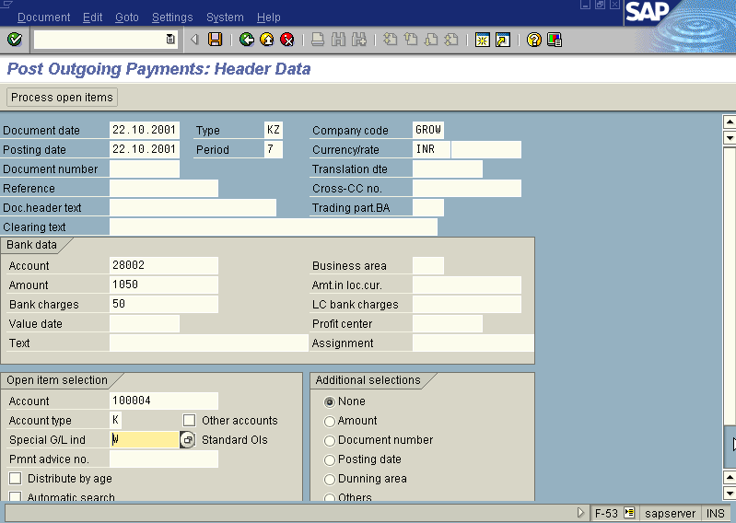
The point to be noted in the above “Post Out Going Payment - Header Data” screen is we have to fill the Spl. G/L Indicator field with “W” (bill of exchange- Bankable) because we are clearing the Spl. G/L item bill of exchange against the invoice.
In the above “Post Out Going Payment - Header Data” screen, with help of the mouse place the cursor on the SPL. G/L Indicator field
Press F4

Slide 44
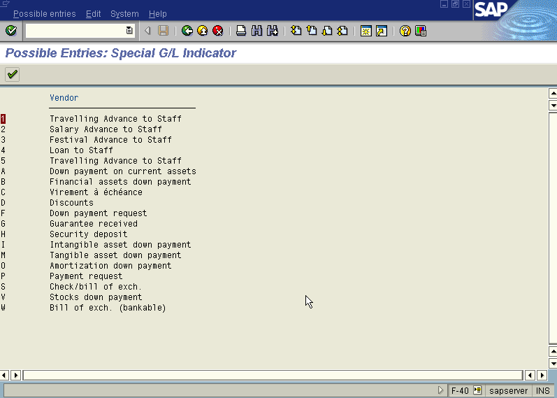
We get the “possible entries- Spl. G/L Indicator” screen as under

Slide 45
Double Click the last item “W” (Bill of Exchange- Bankable) with the help of the mouse,
Press button
Press button so that the item “W” appears on the above “Post Out Going Payment - Header Data ” screen under the field “ Spl. G/L ind.”.
Press process open item button
A screen relating to the “Tax Data” will appear as under

Slide 46
Press continue button
The system will display the below message
Press continue button
The system will display the below warning message.
GL account 85008 is relevant to tax, check code
Press continue button
Now we get “ Post Out Going Payment – Process Open Items” screen as below

Slide 47
In the above “ Post Out Going Payment – Process Open Items” screen
Press icon (Select all) so that all items will be highlighted in blue.
Press icon (Deactivate items) so that all items highlighted in blue turns to normal in black

Slide 48
Now use the Scroll bar on the above “ Post Out Going Payment – Process Open Items” screen till we find our Invoice on the above Screen. Then once we have found the Invoice we wanted to post, Just double click with the mouse on the Amount field eg. 1000 in this case so the amount highlighted will turn to blue colour and the Not assigned field will turn to Zero . Here we should keep in mind that this Not assigned field has to be brought to zero to make the posting.
Press Save button
The system will display a message as under
Document 1500098 was posted in company code GROW
Take a note of the document number ; 1500098
This is the stage where “Post Out Going payment” stage is complete
The document can be seen from Document Display from the top left hand side of the main screen “post out going payment - Header Data“ OR from Transaction code FB- 03 .The Document overview screen will be displayed as under showing the entries.

Slide 49
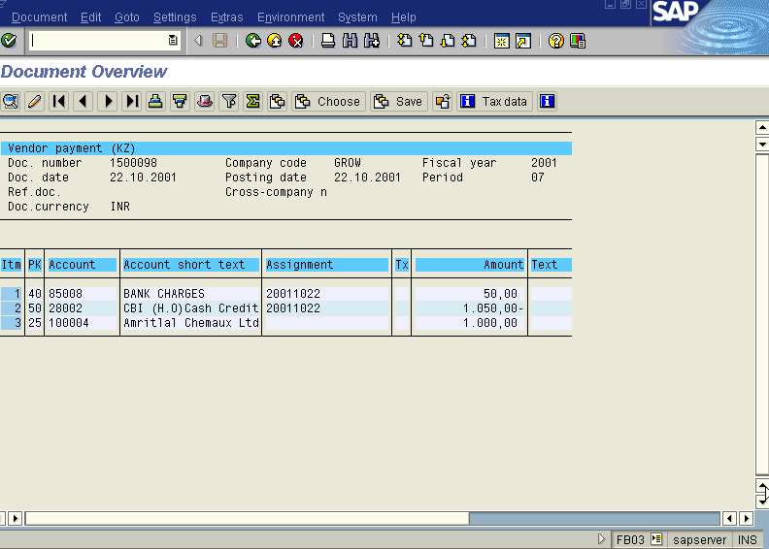

Slide 50
Post Bill of Exchange Vendor (Imports)
S.NO. : 01-FI-AP-06
TRANSACTION CODE : F – 40
ACCESS PATH : SAP Easy Access -Accounting Financial Accounting - Document Entry- Bill of Exchange Payment
On the screen “ Bill of exchange Payment: Header Data”, enter information in the fields as specified table below:
Required fields:
Document date : To be entered
Document Type : Defaults to “KZ”
Company Code : Default (after entered for First Time)
Posting Date : Default (after entered for First Time)
Period : Default (after entered for First Time)
Currency : Default at INR to be changed to Euro
Transaction to be
Processed : Defaulted at outgoing payment
Posting Key : Default
Account : To be entered
Spl. G/L Ind. : Default (at “W” –Bill of exchange – Bankable)
We get the “Bill Of Exchange Payment – Header Data” screen as below

Slide 51
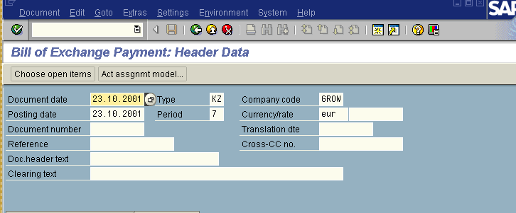

Slide 52
On the above “Bill Of Exchange Payment – Header Data” screen
Press choose open item button
We will get “Bill Of Exchange Payment - Add Vendor Item” Screen
Required fields;
mount : To be entered in EURO currency & Inr currency
Due Date : To be entered
Rest all items viz; Drawer,Drawee details etc. are by default.
After Incorporating the above data in the above “Bill Of Exchange Payment - Add Vendor Item” Screen we get the display as hereunder;

Slide 53
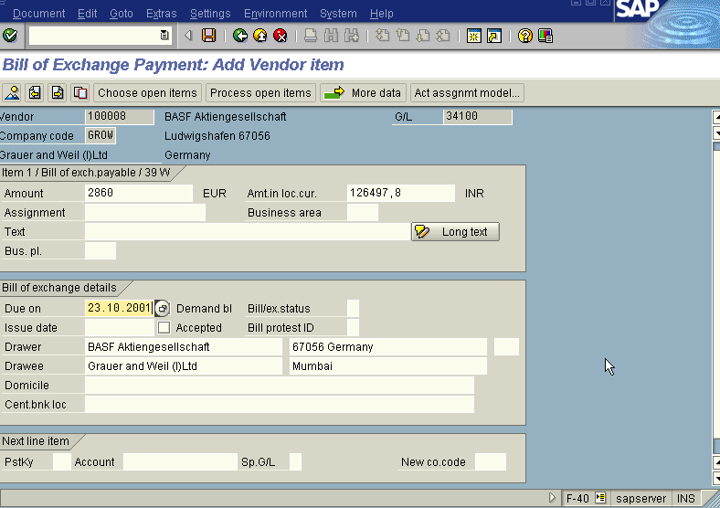

Slide 54
In the above “Bill Of Exchange Payment - Add Vendor Item” Screen
Press process open item button
The system displays the following message as under
Calculate rate 44.23000 deviates from document header rate 5088195 by 13%
Press enter button
We get the “Bill Of Exchange Payment - select open items” screen
In the above “Bill Of Exchange Payment - select open items” screen the fields viz; company code, account (Vendor account number), account type appear as default. The screen will be displayed as under

Slide 55
In the above “Bill Of Exchange Payment - select open items” screen, We leave the SPL. G/L Indicator field blank because we are clearing the bill of exchange against the invoice
Press button
We get “Bill of Exchange Payment – Process open items” screen as under

Slide 56
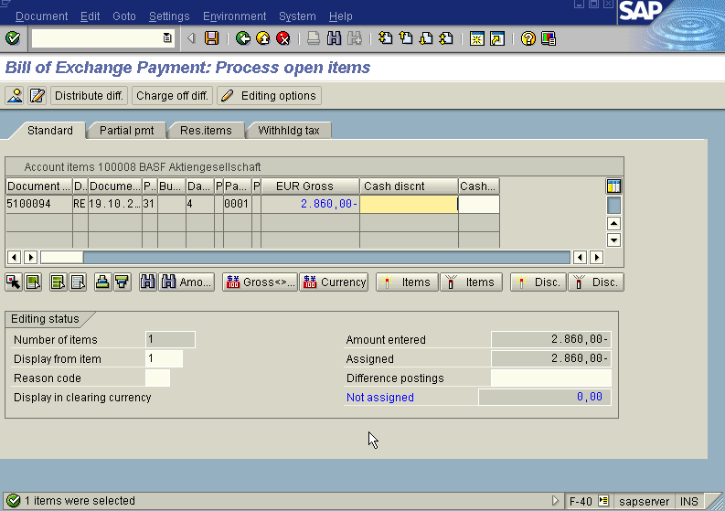
In the above “Bill of Exchange Payment – Process open items” screen
Press icon (Select all) so that all items will be highlighted in blue.
Press icon (Deactivate items) so that all items highlighted in blue turns to normal in black

Slide 57
Now use the Scroll bar on the above “Bill of Exchange Payment – Process Open Items” screen till you find your Invoice on the above Screen. Then once we have found the Invoice we wanted to post, Just just double click with the mouse on the Amount field eg. 2860 Euro in this case so the amount highlighted will turn to blue colour and the Not assigned field will turn to Zero . Here we should keep in mind that this Not assigned field has to be brought to zero to make the posting.
Press Save button
Document number 1500104 was posted to GROW
Take a note of the document number ; 1500104
This is the stage where “Bill of Exchange Payment” stage is complete
The document can be seen from Document Display from the top left hand side of the main screen “post out going payment - Header Data“ OR from Transaction code FB- 03 .The Document overview screen will be displayed as under showing the entries.

Slide 58
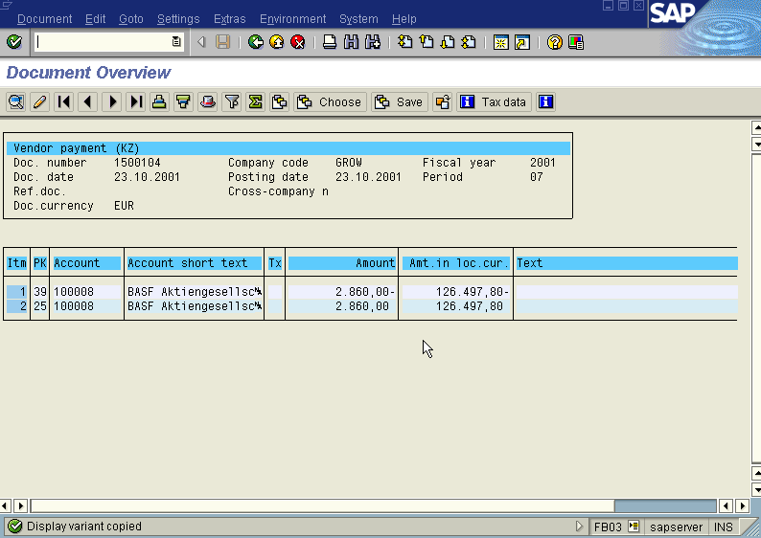

Slide 59
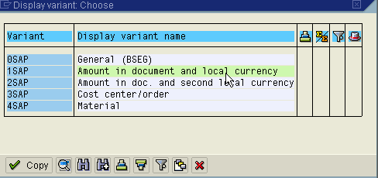
In the above screen the field amount in local currency can be got by chossing button and we are displayed with “Display Variant choose” screen as under

Slide 60
In the above screen choose variant Amount in document and local currency so that in the above “Document Overview” screen showing the entries passed the amount field will appear in Euro & Inr currency.
To know the exchange rate quoted press (Document Header) Icon from “ Document Overview” screen. We get “ Document Header – Company Code GROW” screen as under from which we can see the exchange rate quoted as under.

Slide 61
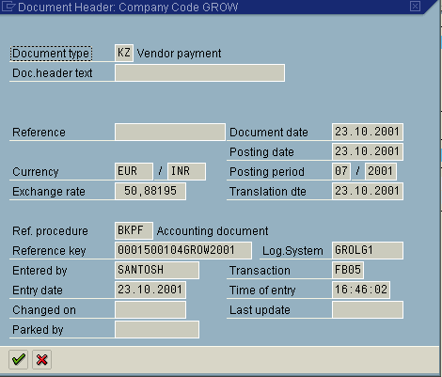

Slide 62
Post Out Going Payment with Bill of Exchange (Imports)
TRANSACTION CODE : F – 53
ACCESS PATH : SAP Easy Access- Accounting Financial Accounting - Accounts Payable – Document Entry- Out going payment- Post
We get “ Post Out Going Payment” Header data” screen ;
Required Fields:
Document date : To be entered
Account : To be entered (Vendor A/c Number)
Account Type : Default
Standard Ois : Default Ticked
Account : To be entered (Bank A/c Number)
Posting date : Default
Amount : Total amount to entered in Euro
Bank Charges : To be entered in Inr
Rest all other fields viz, Doc Type, Period, Companycode,Currency are default after they are entered for the first time.Exchange rate also to be entered (eg: 44 Current Market Rate on the day of making Payment)

Slide 63
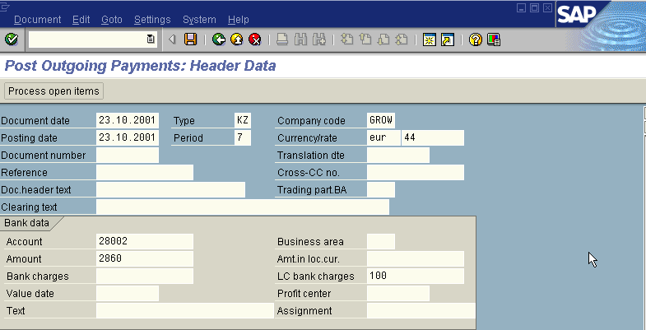
We get the Screen “Post Out Going Payment - Header Data“ incorporating the above mentioned required fields as under;

Slide 64
The point to be noted in the above “Post Out Going Payment - Header Data” screen is we have to fill the Spl. G/L Indicator field with “W” (bill of exchange- Bankable) because we are clearing the Spl. G/L item bill of exchange against the invoice.
In the above “Post Out Going Payment - Header Data” screen, with help of the mouse place the cursor on the SPL. G/L Indicator field
Press F4
We get the “possible entries- Spl. G/L Indicator” screen as under

Slide 65
Double Click the last item “W” (Bill of Exchange- Bankable) with the help of the mouse,
Press button
Press button
so that the item “W” appears on the above “Post Out Going Payment - Header Data ” screen under the field “ Spl. G/L ind.”.
Press process open item button
The system gives a message as under
Exchange rate 4400000 deviates from table rate 5088195 by 13.51%
Press Enter Icon
A screen relating to the “Tax Data” will appear as under

Slide 66
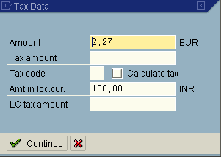
Press continue button
The system will display the below message
GL account 85008 relavant to tax check code
Press continue button
Now we get “ Post Out Going Payment – Process Open Items” screen as below

Slide 67
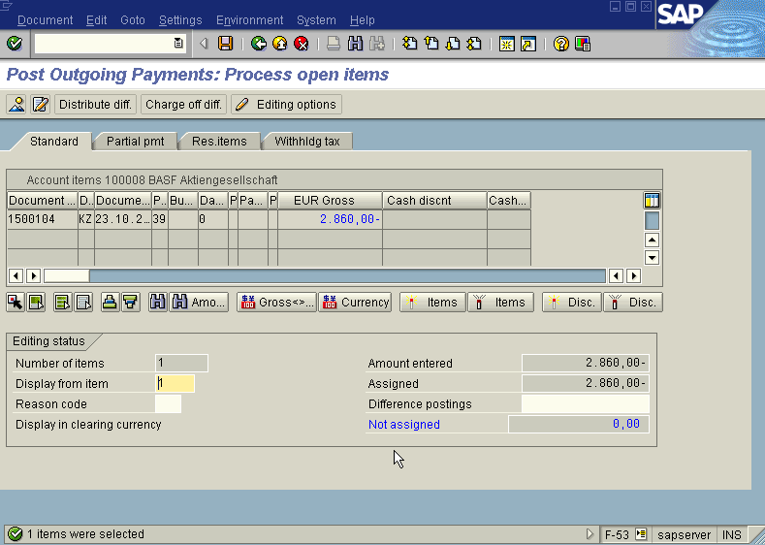
In the above “ Post Out Going Payment – Process Open Items” screen
Press icon (Select all) so that all items will be highlighted in blue.
Press icon (Deactivate items) so that all items highlighted in blue turns to normal in black

Slide 68
Now use the Scroll bar on the above “ Post Out Going Payment – Process Open Items” screen till we find our Invoice on the above Screen. Then once we have found the Invoice we wanted to post, Just double click with the mouse on the Amount field (eg. 2860 Euro in this case) so the amount highlighted will turn to blue colour and the Not assigned field will turn to Zero . Here we should keep in mind that this Not assigned field has to be brought to zero to make the posting.
Press Save button
The system will display a message as under
Document 1500105 was posted to company code GROW
Take a note of the document number ; 1500105
This is the stage where “Post Out Going payment” stage is complete
The document can be seen from Document Display from the top left hand side of the main screen “post out going payment - Header Data“ OR from Transaction code FB- 03 .The Document overview screen will be displayed as under showing the entries.

Slide 69
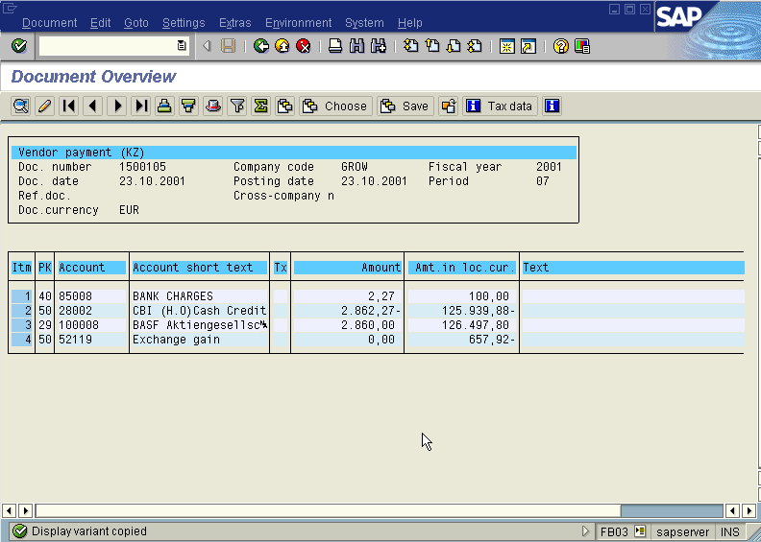

Slide 70
In the above screen the field amount in local currency can be got by clicking button and we are displayed with “Display Variant choose” screen as under

Slide 71
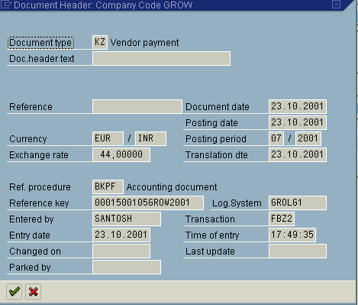
In the above screen choose variant Amount in document and local currency so that in the above “Document Overview” screen showing the entries passed the amount field will appear in Euro & Inr currency.
To know the exchange rate quoted press (Document Header) Icon from “ Document Overview” screen. We get “ Document Header – Company Code GROW” screen as under from which we can see the exchange rate quoted as under

Slide 72
Invoice Booking with TDS (at Invoice)
S.NO. : 01- FI-AP- 08
TRANSACTION CODE : FB60
ACCESS PATH :SAP Easy Access- Accounting - Financial Accounting - Accounts Payable - Document Entry - Invoice
Note: If the particular vendor who has to be invoiced/paid doesn’t exist, we need to go to SAP Easy Access Accounting Financial Accounting Accounts Payable Master Data Create or TRANSACTION CODE : FK01 and create a vendor.
We get “Vendor Invoice Enter” Screen as under;
Required Fields:
Vendor To be entered
Invoice Date To be entered
Posting date Default
Reference To be entered (eg:Invoice Number)
Amount To be entered
Business Place To be entered
In the following table select the particular expense G/L Account and enter the amount of the invoice. Incorporating the above fields the invoice will be as under;

Slide 73
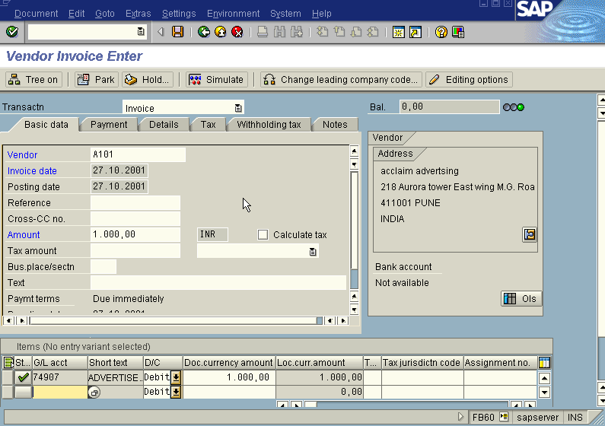
Press Enter Icon
The system gives the message as under
GL account 74097 is relevant to tax, check code
In the above screen press the with holding tax push button and in that screen enter the amount in which TDS has to be deducted. The new screen will be displayed as under:

Slide 74
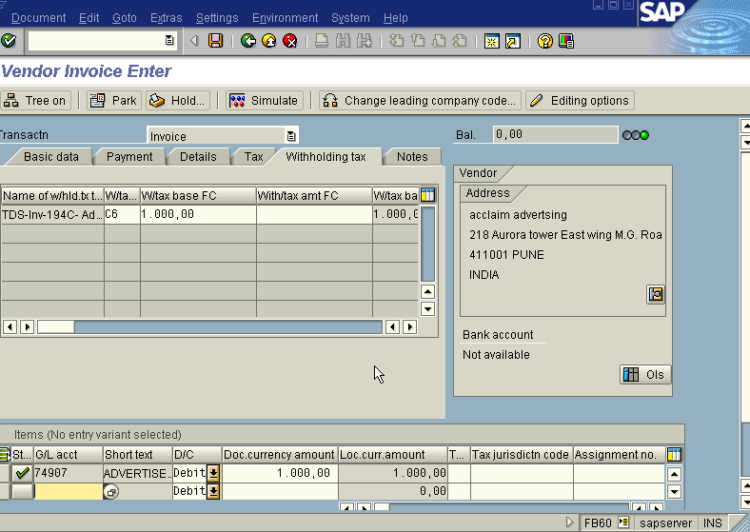
Press Enter icon
Press Save icon
We get the message as under
Document 1900024 was posted to company code GROW
Take a note of this above number : 1900024
To see the following entries passed go to the main screen “Vendor Invoice Enter”
Document Display or FB03. we get the “Document Overview” Screen as under

Slide 75
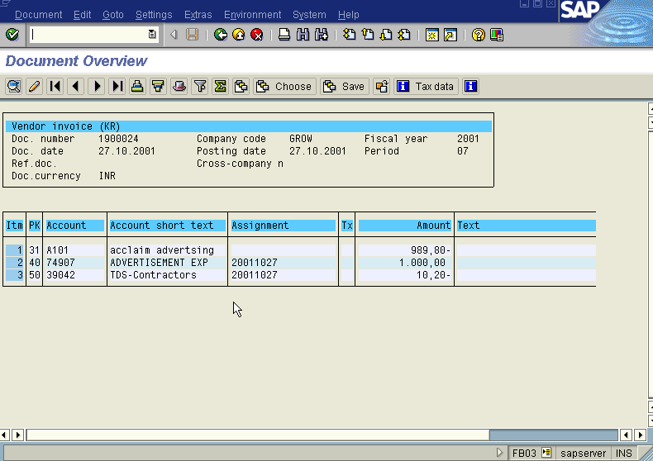
Note: Enter the business place in all the transactions passed by clicking the line items so as to enable us to post and update chalan and thereafter to take the print outs of Certificate

Slide 76
Post Out Going Payment with TDS (at Invoice)
S.NO. : 01- FI-AP- 09
TRANSACTION CODE : F – 53
ACCESS PATH : SAP Easy Access- Accounting - Financial Accounting - Accounts Payable – Document Entry - Out going payment- Post
We get “ Post Out Going Payment” Header data” screen ;
Required Fields:
Document date : To be entered
Account : To be entered (Vendor A/c Number)
Account Type : Default
Standard Ois : Default Ticked
Account : To be entered (Bank A/c Number)
Posting date : Default
Amount : Net amount excluding the TDS amount to be entered
Bank Charges : To be entered
Rest all other fields viz, Doc Type, Period, Company code, Currency/Rate are default after they are entered for the first time.
We get the Screen “Post Out Going Payment - Header Data“ incorporating the above mentioned required fields as under;

Slide 77

Press process open item button
Now we get “ Post Out Going Payment – Process Open Items” screen as below

Slide 78
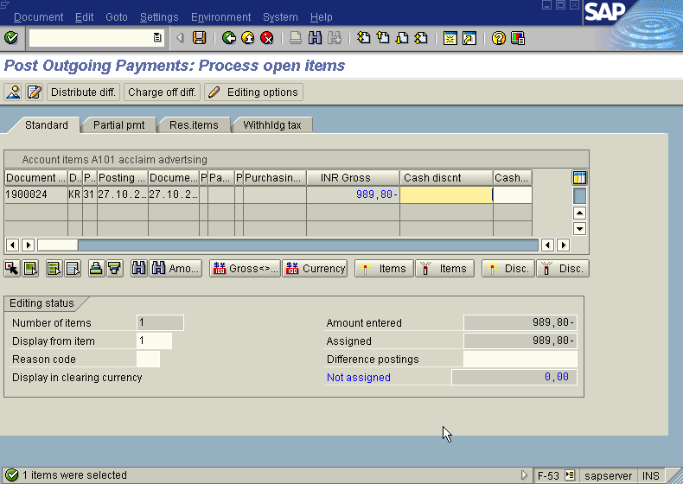
In the above “ Post Out Going Payment – Process Open Items” screen
In the above case there is only one open item to process and the Not assigned field is Zero so press save icon. And take a note of the document number.
If there are more process open item on the above screen follow the step as below:
(Press icon (Select all) so that all items will be highlighted in blue.

Slide 79
Press icon (Deactivate items) so that all items will be highlighted in blue turns to normal in black
Now use the Scroll bar on the above “ Post Out Going Payment – Process Open Items” screen till you find your Invoice on the above Screen. Then once we have found the Invoice we wanted to post, Just just double click with the mouse on the Amount field eg. 989.80 in this case so the amount highlighted will turn to blue colour and the Not assigned field will turn to Zero . Here we should keep in mind that this Not assigned field has to be brought to zero to make the posting.)
Press Save button
The system will display a message as under
Document 1500118 was posted to company code GROW
Take a note of the document number ; 1500118
This is the stage where “Post Out Going payment” stage is complete
The document can be seen from Document Display from the top left hand side of the main screen “post out going payment - Header Data“ OR from Transaction code FB- 03 .The Document overview screen will be displayed as under showing the entries.

Slide 80
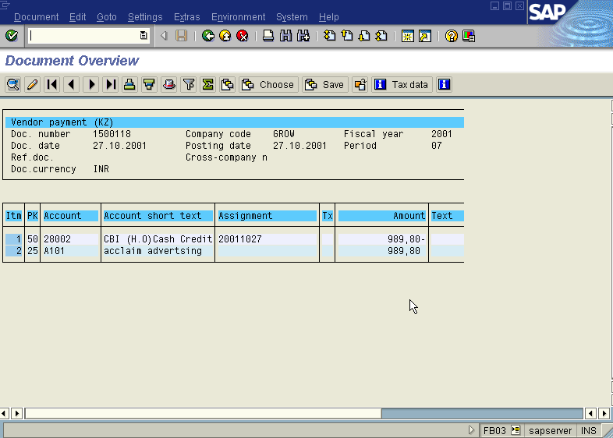
Note: Enter the business place in all the transactions passed by clicking the line items so as to enable us to post and update challans and thereafter to take the print outs of Certificate

Slide 81
Invoice Booking with TDS (at Payment)
S.NO. : 01- FI-AP- 10
TRANSACTION CODE : FB60
ACCESS PATH :SAP Easy Access- Accounting Financial Accounting- Accounts Payable- Document Entry- Invoice
Note: If the particular vendor who has to be invoiced/paid doesn’t exist, we need to go to SAP Easy Access Accounting Financial Accounting Accounts Payable Master Data Create or TRANSACTION CODE : FK01 and create a vendor.
We get “Vendor Invoice Enter” Screen as under;
Required Fields:
Vendor To be entered
Invoice Date To be entered
Posting date Default
Reference To be entered (eg:Invoice Number)
Amount To be entered
In the following table select the particular expense G/L Account and enter the amount of the invoice. Incorporating the above fields the invoice will be as under;

Slide 82
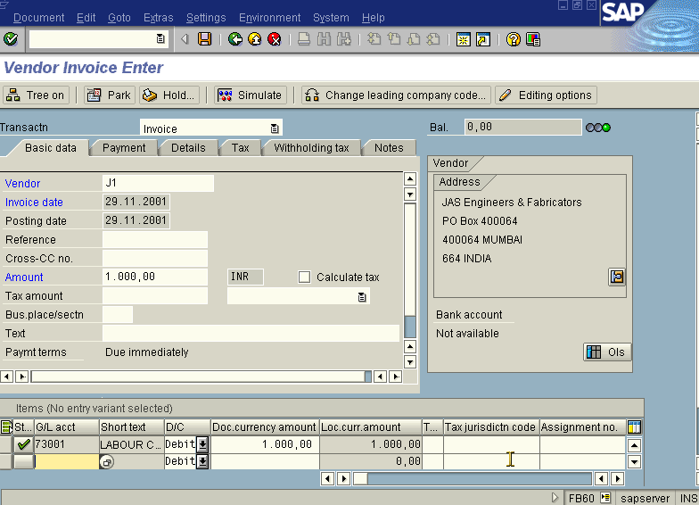
Press Enter Icon
The system gives the message as under
GL account 74907 is relevant to tax, check code

Slide 83
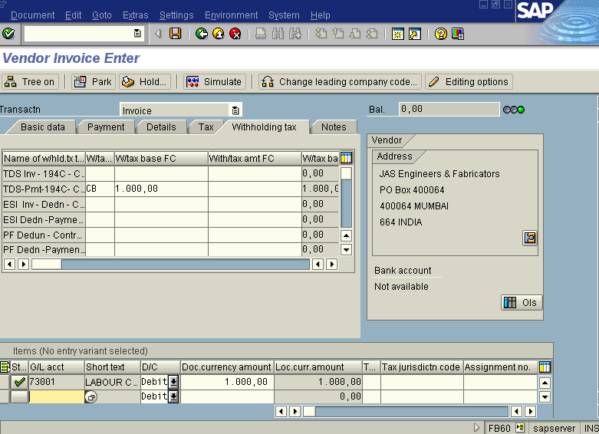
In the above screen press the with holding tax push button and in that screen enter the amount in which TDS has to be deducted. The new screen will be displayed as under:

Slide 84
Note:
If payment is to be deducted at payment level then retain the relevant with holding
tax item and delete all other with holding tax codes in the above screen.
If PF & ESI contribution is to be deducted then retain that also at the above
screen.
Press Enter icon
Press Save icon
Take a note of this above number : 1900101
To see the following entries passed go to the main screen “Vendor Invoice Enter”
Document Display or FB03. we get the “Document Overview” Screen as under;

Slide 85
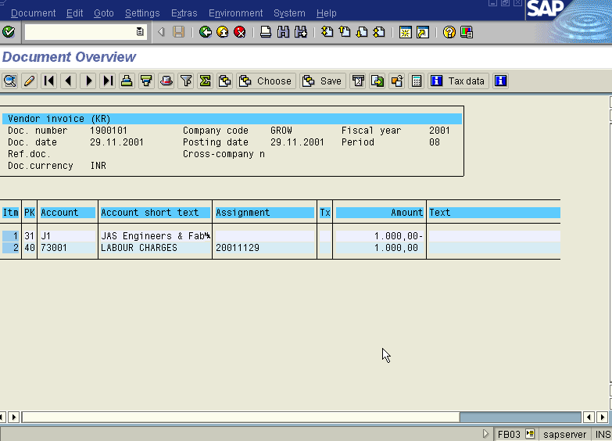
Note: Enter the business place in all the transactions passed by clicking the line items so as to enable us to post and update challans and thereafter to take the print outs of Certificate

Slide 86
Post Out Going Payment with TDS (at Payment)
S.NO. : 01- FI-AP- 11
TRANSACTION CODE : F – 53
ACCESS PATH : SAP Easy Access- Accounting- Financial Accounting - Accounts Payable – Document Entry - Out going payment- Post
We get “ Post Out Going Payment” Header data” screen ;
Required Fields:
Document date : To be entered
Account : To be entered (Vendor A/c Number)
Account Type : Default
Standard Ois : Default Ticked
Account : To be entered (Bank A/c Number)
Posting date : Default
Amount : Net amount excluding the TDS amount to be entered
Bank Charges : To be entered
Rest all other fields viz, Doc Type, Period, Company code, Currency /Rate are default after they are entered for the first time.
We get the Screen “Post Out Going Payment - Header Data“ incorporating the above mentioned required fields as under;

Slide 87
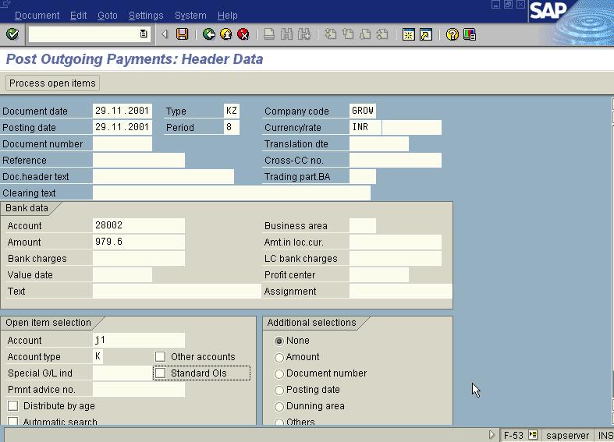
In the above screen take the net amount
Press process open items button
Now we get “ Post Out Going Payment – Process Open Items” screen as below

Slide 88
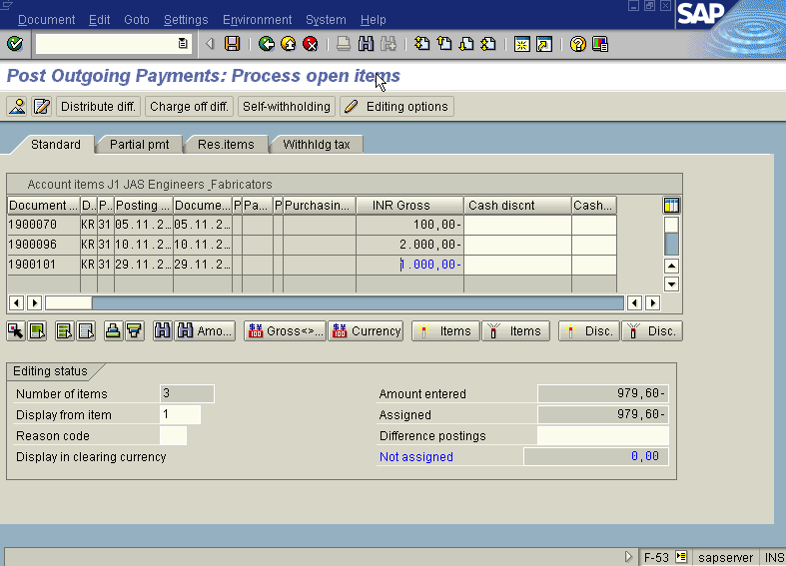
In the above “ Post Out Going Payment – Process Open Items” screen
In the above case there is only one open item to process and the Not assigned field is Zero so press save icon. And take a note of the document number.
If there are more process open item on the above screen follow the step as below:
(Press icon (Select all) so that all items will be highlighted in blue.

Slide 89
Press icon (Deactivate items) so that all items will be highlighted in blue turns to normal in black
Now use the Scroll bar on the above “ Post Out Going Payment – Process Open Items” screen till you find your Invoice on the above Screen. Then once we have found the Invoice we wanted to post, Just just double click with the mouse on the Amount field eg. 979.60 in this case so the amount highlighted will turn to blue colour and the Not assigned field will turn to Zero . Here we should keep in mind that this Not assigned field has to be brought to zero to make the posting.)
Press Save button
Take a note of the document number ; 1500215
This is the stage where “Post Out Going payment” stage is complete
The document can be seen from Document Display from the top left hand side of the main screen “post out going payment - Header Data“ OR from Transaction code FB- 03 .The Document overview screen will be displayed as under showing the entries.

Slide 90
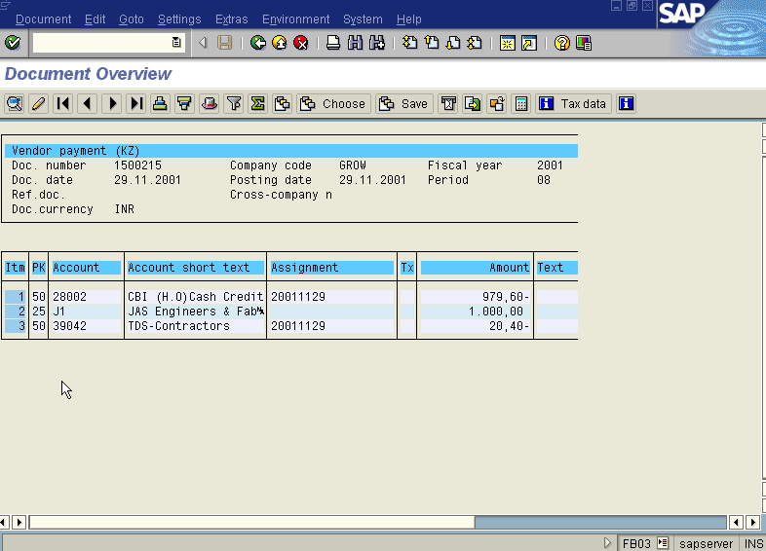
Note: Enter the business place in all the transactions passed by clicking the line items so as to enable us to post and update challans and thereafter to take the print outs of Certificate

Slide 91
Interest Calculation for Vendors (Balance Interest)
Step 1: Incorporating interest indicator in Vendor master
Path
SAP Easy Access → Accounting → Financial Accounting → Accounts Payable → Master Records → Change
Transaction Code FK02
We get Change Vendor initial Screen
Vendor M4 (Mathur)
Company Code GROW
Select/ Put tick on the relevant options
Press Enter
We get Change Vendor: Accounting Information Accounting Screen

Slide 92
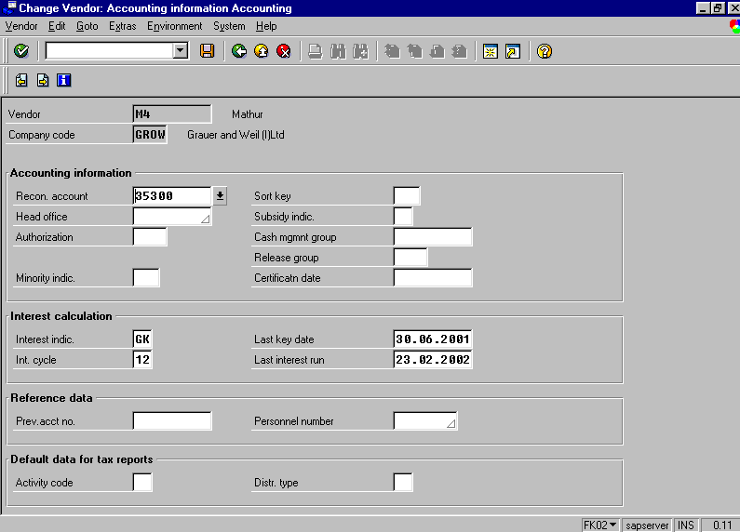
Note: Interest Indicator in the above screen should be set at GK for calculating Interest on Loan to staff

Slide 93
Step2: Interest Calculation
Path
SAP Easy Access → Accounting → Financial Accounting → Accounts Payable → Periodic Processing → Interest Calculation → Balance
Transaction Code F.44
Note: Indicator should be set at GK in the Vendor Interest scale Screen
Press Execute F8
We get Display Text Screen where we can see the interest calculated on the following the documents
We get calculation of Interest on arrears screen
Where we get the information batch input session RFDUZI00 created
Then Finally go to
Transaction Code SM35 and run the Batch Input Process
The system will post the interest calculated to books of accounts of the customer.
Similarly for Fixed Deposits follow the above procedure and by changing to relevant Interest indicator. (GH / GK)

Slide 94
